Slide 1


Intro to Biostatistics
Dr. Abolfazl Saghafi
Assistant Professor of Statistics
Data Science Program Director

Slide 2

ST 310 Biostatistics 1
Instructor: Dr. Abolfazl Saghafi
Office: STC 209
Email: A[DOT]Saghafi[AT]USciences.edu
Phone: (215) 5NINE6-7TWO4ZERO
Office Hours: TBA 10:00-11:50
3:00-3:50
(email me prior)
* Additional help at the Tutoring Center in GRI 344 (215-596-7541)
Notes:
I will be more than happy to help you with your questions.
Additional help at the Tutoring Center in GRI 344 (215-596-7541)

Slide 3

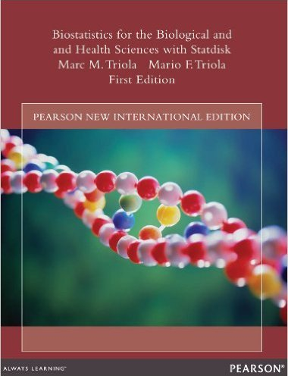
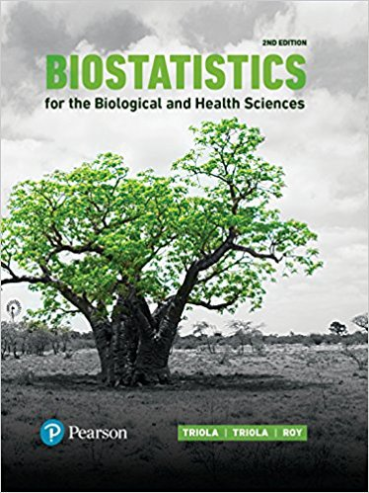

Suggested Textbook
Biostatistics for the Biological and Health Sciences, 1st edition, by Marc and Mario Triola, (ISBN: 0321194365). Two copies available in the library, access only in the library. There is an optional student solutions manual to accompany the textbook.
1st Edition (2006)
1st Edition (2014)
International ed.
2nd Edition (2017)
Supplementary
Notes:
You can find used copies of the 1st edition for as little as $10-$15
$10 is the e-book of the supplementary book, it’s a fun book to read if you’re into manga and comic books

Slide 4
Table of Contents
Chapter 1 Introduction to Biostatistics Chapter 2 Describing, Exploring, and Comparing Data Chapter 3 Probability Chapter 4 Discrete Probability Distributions Chapter 5 Normal Probability Distributions Chapter 6 Estimates and Sample Sizes with One Sample Chapter 7 Hypothesis Testing with One Sample Chapter 8 Inferences from Two Samples Chapter 9 Correlation and Regression
Notes:
These are the subjects and chapters we will cover in the course

Slide 5
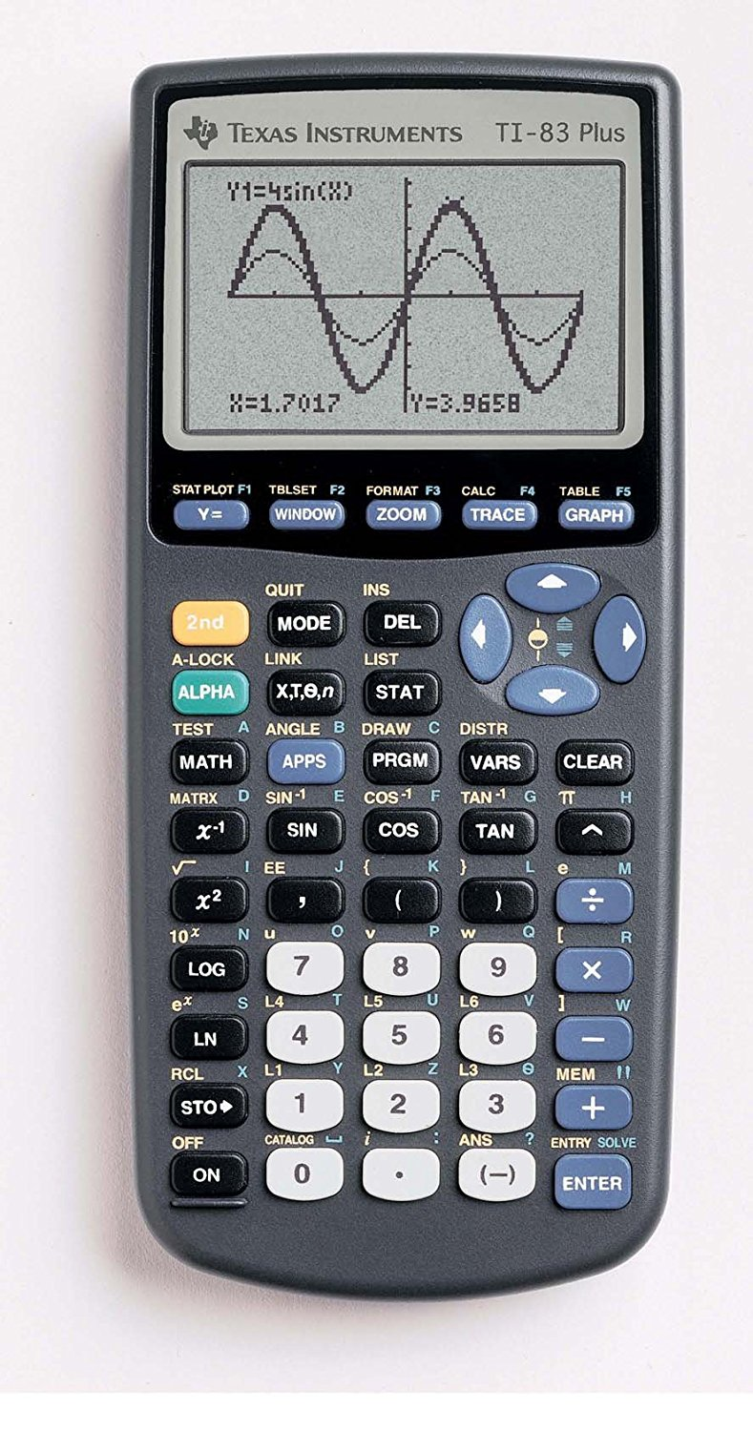

Technology
All computing will be done using Excel 2017 and the TI-83+/TI-84+ calculator. Instructions on how to use Excel 2017 and the calculator will be available in handouts on Blackboard. Blackboard will contain the syllabus, lectures, handouts, solutions to practice problems, lecture-captured videos, practice exams, datasets, Excel and calculator instructions, exam seat assignments, and other course related material. Check Blackboard regularly for new posts.
Notes:
For this course you need a scientific calculator that performs statistical calculations. You may use any scientific calculator, I recommend TI-83 and 84, I may not be able to help you for any other calculator.
You will learn how to use Excel to do basic data summarization and create graphs

Slide 6
Grading Rubric
Attendance below 80% and missing more than 1 assignment results in a F grade.
Up to 3% extra credit is awarded for scoring the post-assessment test. Refer to syllabus for details.
Attendance has 2% of your course grade. If you have more than 90% attendance, you’ll have the 2%.
100%
16% - M1
16% - M2
16% - M3
20% - Final
15% - CH
15% - PR
Chapter Assignments (CH):
9 chapter assignments, should be completed on blackboard prior to due dates. The lowest score among the 9 will be dropped. See the syllabus for due dates.
Group Project (PR):
A project in three phases, the details are provided in the syllabus and in blackboard.
Notes:
Post-assessment extra credit is only given to students who take BOTH pre-test and post-test assessment tests.
We will be using Tuesday schedule for the first midterm test, reach out to me if you have exam conflicts PRIOR (at least one week) to the tests

Slide 7

Exam Policy
Exams are closed book
You may bring ONE sheet of formula ONE-SIDED to each midterm exam. You can bring all three formula sheets plus one sheet extra to the final exam
The sheets should be standard 8.5x11
Pre-assessment test:
Tue, Jan 14, 2020 (1:00-2:00) (2:00-3:00) in Old Gym
* Academic integrity is at the center of the educational experience at USciences. Students are expected to uphold the highest standards of academic integrity and not engage in or tolerate academic dishonesty.
Notes:
Start working on your formula sheet as you are reading the materials, it could be overwhelming to write it in a night before the test.

Slide 8
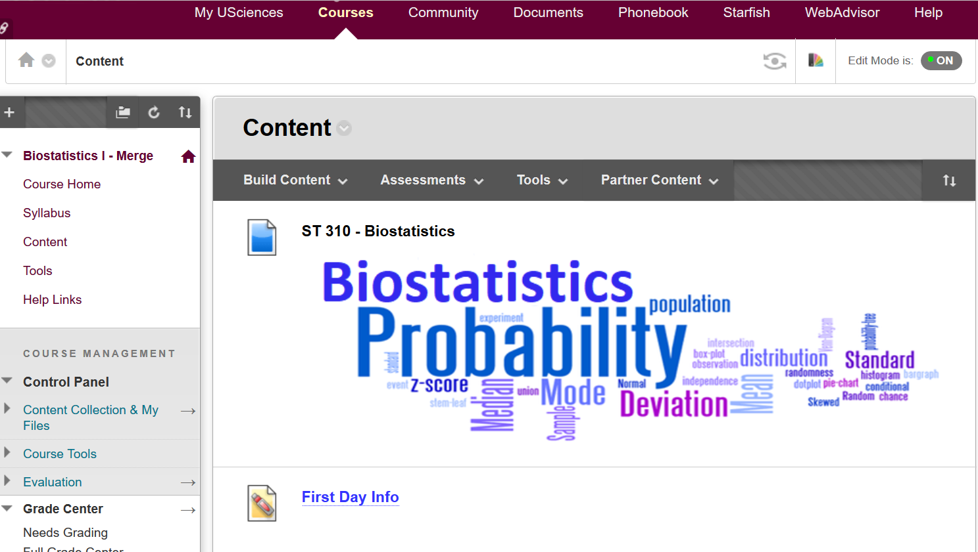

Class Recording
Lectures (for an online class) are available on D2L for students registered in the course.
* Use of lecture capture is intended to supplement the classroom experience. Duplication or redistribution of lecture capture recordings is prohibited without appropriate consent.
Notes:
Check the lecture capture if you miss a class to catch up or to review the class

Slide 9

Acadly
I will be using ACADLY to keep track of the attendance and do some in class quizzes.
Take a few moments to download this free app and register with your USciences account
Notes:
Section 1 join code: F7XBVU
Section 4 join code: ENETYB

Slide 10

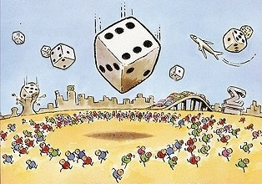
Notes:
Be curious about these stuff and things will be fun

Slide 11
Biostatistics
Biostatistics is the application of statistics to a variety of topics in biology.
Statistics (as opposed to statistic) is the science of gathering, organizing, analyzing, and interpreting data/information.
In this course, we tend to focus on biological topics in the health sciences as we learn about statistics.
Notes:
I present course materials with examples in many real-life phenomenon including health sciences

Slide 12
Biology
Computer Science
Business
Statistics
Environment
Engineering
Sociology
Sport
Education
Notes:
Statistics is used everywhere, it is interdisciplinary. We actually have students in this class from many of these subject areas. Can you think of some applications of statistics in these areas
In Biology which is our main focus
Does a new drug works better (Comparison)
What are Risk factors for cancer/heart attack (Component Analysis)
How long will I survive under such conditions (Prediction)
If the drug worked on a small sample will it work for a larger group? (Generalization)
Is there a relation between blood pressure and stress? (Association)

Slide 13

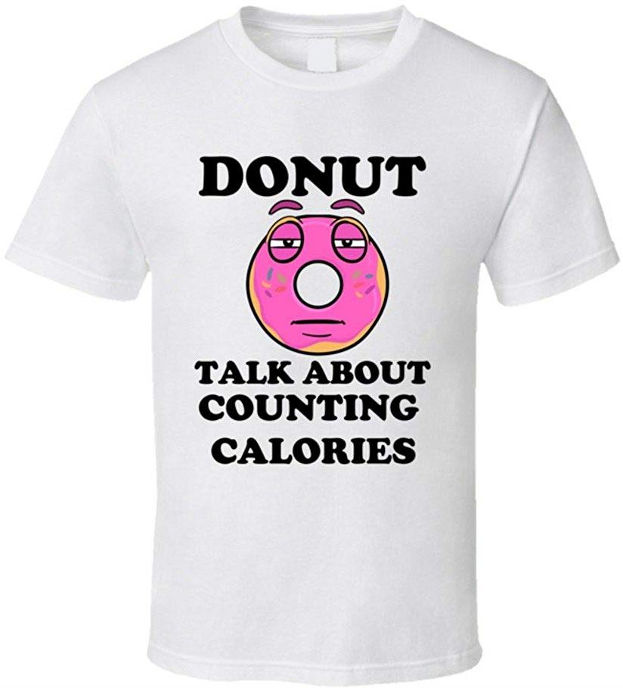

Using Statistics in everyday Life
Usually with little effort you estimate
when to leave home to be in class on time
to make a balance between earnings and expenses each week/month
counting the calories you eat
While driving
With this course you learn to Make Data-driven decisions
Notes:
Believe it or not, you use statistics in your everyday life with less effort, usually by trying and error
Can you recall any other applications that you’re using regularly?

Slide 14
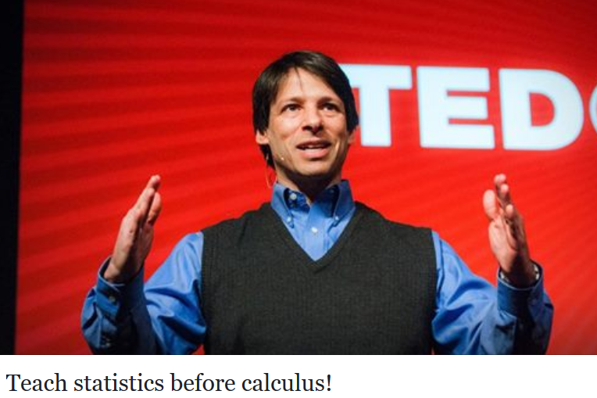
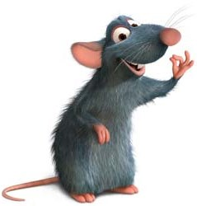
Why Statistics!
Very few people actually use calculus in a conscious, meaningful way, in their day-to-day lives.
On the other hand, statistics is a subject that you could, and should, use on daily basis. It's risk. It's reward. It's randomness. It's understanding what happens around you.
ANYONE CAN LEARN ANYTHING
If puts the mind and effort into it
Notes:
Check out that TedTalk, it’s about 20 minutes, totally worth it
Don’t tell this to your calculus teacher :P keep it between us
TOUT LE MONDE PEUT, APPRENDRE TOUT

Slide 15

● Browse class slides BEFORE class, print the class slides, then come to class and pay attention, take notes
● ASK QUESTIONS if you do not understand something, odds are you aren't the only one. Take advantage of the office hours. You can also get free tutoring on Tutoring Center in GRI 344, call for information: 215-596-7541
● PRACTICE, try to work the examples yourself, spend time on solving practice problems, watching me solve the problems or reading the answers is not enough
● GET HELP EARLY if you are struggling. If you wait until the night before the test to learn weeks’ worth of material it can be overwhelming
● DO NOT wait until the last minute to start the homework assignments
Notes:
In or Out
I promise you’ll have fun along the way ;)

Slide 16
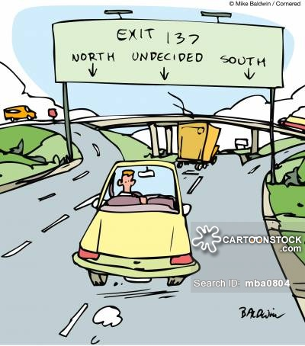
Introduction to Biostatistics
Chapter 1
Part 1
Notes:
Fasten your seatbelts, It’s about to get schwifty!

Slide 17
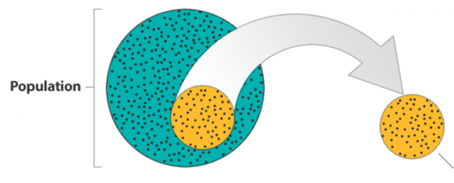
Population / Sample
The process of statistics starts when we identify what group we want to study or learn something about. We call this group the population.
Due to some limitations (time, cost, feasibility, etc.) a more practical approach would be to examine and collect data only from a sub-group of the population, which we call a sample.
https://bolt.mph.ufl.edu/6050-6052/preliminaries/the-big-picture/
Notes:
The population, is the entire group that is the target of our interest. It is not just used to refer to people; could also refer to animals, things etc. It could be adult population in the US, we would like to study their sleep patterns, how many hours they sleep each night.
In most cases, the population is so large that as much as we might want to, there is absolutely no way that we can study all of it (imagine trying to get the opinions of all U.S. adults about the death penalty…).

Slide 18
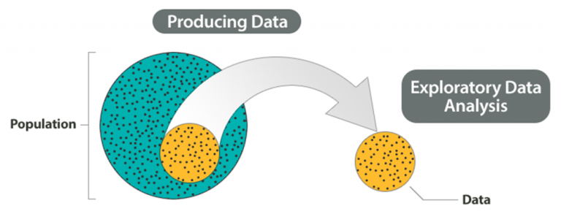
Descriptive Statistics
We should make an effort to choose a sample in such a way that it represents the population well. We call this first component, which involves choosing a sample and collecting data from it, Producing Data.
The second component, which consists of summarizing the collected data, is called Descriptive Statistics or Exploratory Data Analysis.
Notes:
No comment, all is in there

Slide 19
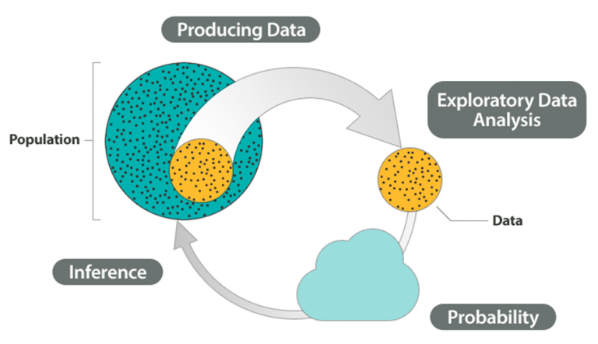
Big Picture
Remember that our goal is to study the population, so what we want is to be able to draw conclusions about the population based on the sample results.
The third component in the Big Picture of Statistics, probability is in essence the “machinery” that allows us to draw conclusions about the population based on the data collected in the sample.
Finally, we can use what we’ve discovered about our sample to draw conclusions about our population. We call this final component in the process Inference.
Notes:
The structure of this entire course is based on the big picture.

Slide 20
Example
Determine population/sample.
1. A Reuters/Zogby poll asked 1000 adults (15-35 yo) if they believe that life exists elsewhere in the universe.
2. A car company tests 100 of their cars to estimate the mean stopping distance for auto brakes while driving at 60 mph.
3. 100 patients with stage-2 liver cancer agree to participate in a study regarding the survival rate and treatments.
4. An anesthetic technician have to know the average time a patient would go to sleep for a given dosage.
Notes:
Write answers on the slide

Slide 21
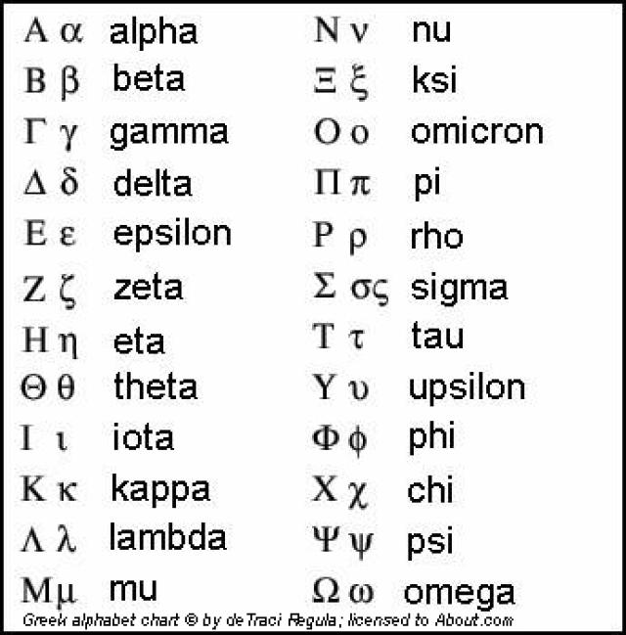
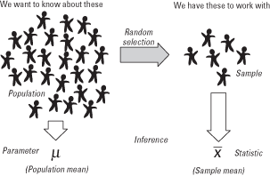
Parameter and Statistic
A parameter is a number that describes the characteristic of the population.
A statistic is a number that describes the characteristic of a sample.
www.cliffsnotes.com/study-guides/statistics/sampling/populations-samples-parameters-and-statistics
Notes:
Parameters are widely shown by Greek letters. Some of these letters are VERY important and we’ll be using them A LOT in this course. Practice writing μ and σ, they represent population mean and population standard deviation, respectively.
Since we don’t normally have access to population data, we estimate these parameters using sample observations. The numbers computed using sample which are used to estimate parameters are called statistic. $\overline{x}$ is a statistic which represents sample mean, s represents sample standard deviation.

Slide 22
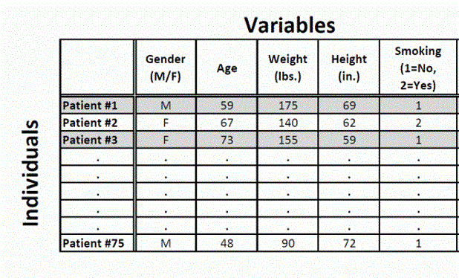
Data
Data are pieces of information about individuals organized into variables.
By an individual, we mean a particular person or object.
By a variable, we mean a particular characteristic of an individual.
A dataset is a set of data identified with a particular experiment, scenario, or circumstance.
For example: you see some demographics and smoking status for a group of patients.
Notes:
The rows in a dataset represent individuals and might also be called observations or cases. The columns represent variables which are characteristics of the individuals.

Slide 23
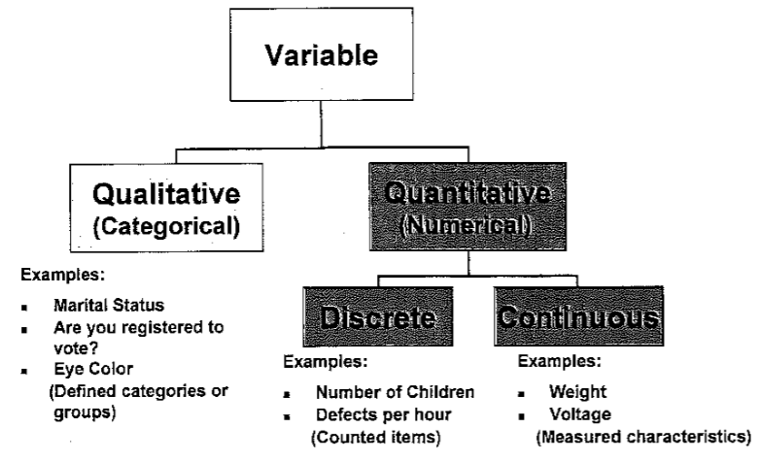
Variable
A variable is a distinct characteristic of an individual to be observed and measured. These observed data can be qualitative or quantitative.
A qualitative (categorical) variable is a variable that describes the individual by placing the individual into a category or group.
A quantitative (numerical) variable is a variable that takes on a real value or numerical measurement for which sums, differences, and ratios have meaning.
Notes:
What we are trying to study is not constant through the population, it changes from individual to individual, therefore it’s called VARIABLE. There are two types of variables.
Can you add more examples of Qualitative and Quantitative variables?

Slide 24
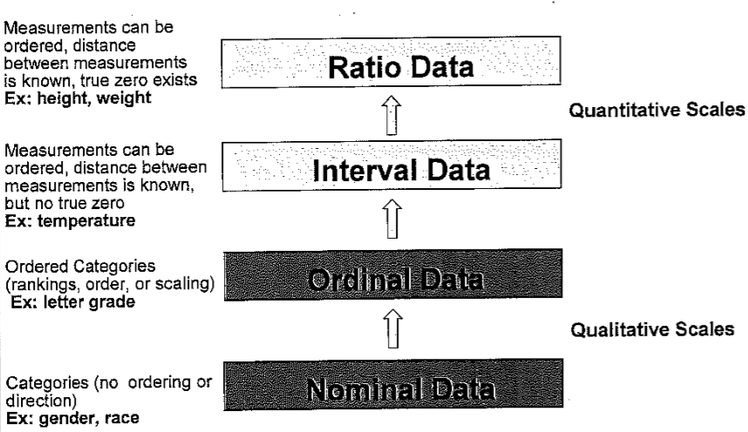
Levels of Measurement
Depending on the variable, the type of data we gather is different.
We can change level of information gathered in higher levels to lower but not the other way around. Example: salary.
Notes:
Nominal data is one that measures a characteristic of an individual by name only; information in the form of categorical data where the order of the categories is not relevant. Gender, Social Security Number, Zip Codes, Race are examples of Nominal Data.
Ordinal data can be arranged in order; however, difference between data values is not the same, cannot be determined, or is meaningless. For example, letter grade, dress and shoe size, Likert scale.
Interval data can be ordered and differences are the same and have meaning, but divisions do not (equal distances, but no fixed zero). For example, temperature, time in 12 hour intervals.
Ratio data has ordinal and interval characteristics, and ratios have meaning (equal distances). Ratio measures have fixed zeros; that is, an interval measure with a true zero. Examples include height, weight, age, etc.

Slide 25
Practice Problems Part 1
For the following variables, determine the variable type (qualitative/quantitative) and measurement scale.
Body temperature (ºC) Dose of aspirin (nil, low, high) Sex
Number of tumors Dose of aspirin (g) pH of soil
Ranking of baseball players Date of birth IQ score
Weight gain (g) Number of viruses on a PC College major
APGAR score (0, 1, or 2) Income ($) Marital Status
Date of harvesting Severity of asthma (mild, moderate, severe)
Smoking status (Yes, No) Temperature inside refrigerators (ºF)
Number of correct answers Income class (upper, middle, low)
Agreement on death penalty(1=disagree, 2= neutral, 3=agree)
Type of crop (0=Wheat, 1= Barley, 2=Oats, 3=Others)
Time required for a computer to process a request
Notes:
Now it’s your turn, see how good you understood the material by solving these problems. Don’t be afraid to make mistakes, it’s a chance to learn. Answers are provided in Ch1 Practice Problem Solutions. Check the right answers and figure out why some of your answers were wrong.

Slide 26
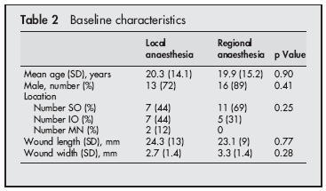
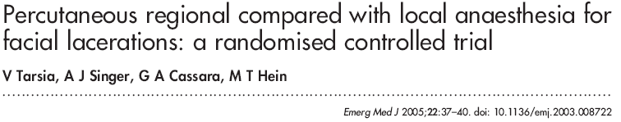
Practice Problems Part 1
The given table is published in the following article. List all the variables in the table and determine their type, level of measurement.
Notes:
Answers are provided in Ch1 Practice Problem Solutions

